Slide 1
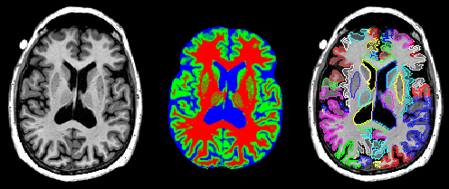
Optimization-based Segmentation of Brain Using a Genetic Algorithm
Tim Ruesink, Grant Roberts, Lawrence Lechuga

Slide 2
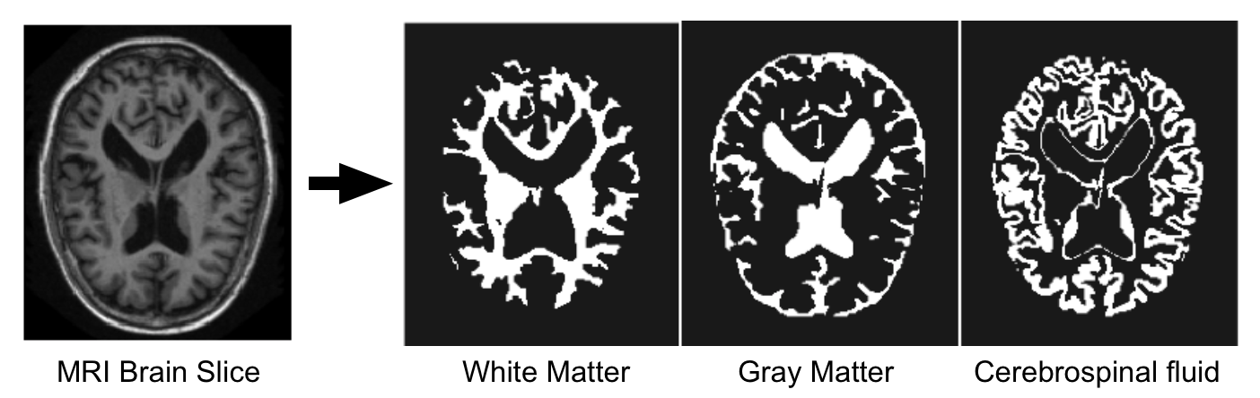
Background
Segmentation: Divide an image into set of meaningful, homogenous, and non-overlapping regions, based on attributes in the image.
Challenges: Partial volume effect, artifacts (motion, etc), complex geometry of objects in question, and noise adds uncertainty to the process.
Common Methods: Thresholding, k-means clustering, atlas, and manual methods
Notes:
We have been introduced to the concept of image segmentation throughout the course. Segmentation is a process by which an image is divided into logical, homogeneous, and non-overlapping regions. For instance, we can segment a brain MRI slice into 3 different tissue types, like white matter, gray matter, and CSF.
Some challenges facing segmentation are imaging artifacts, like motion, and things like partial voluming effects and complex shapes of the regions of interest, and of course noise. The addition of noise creates a situation where assigning pixel values becomes probabilistic by nature.
For these reasons, image segmentation can become a very difficult problem where certain situations need a different approach than others. There are many different methods to use like: intensity, atlas, and surface-based methods, and of course manual segmentation. Each one being more appropriate than others in certain situations and having their own layers of complexity.

Slide 3
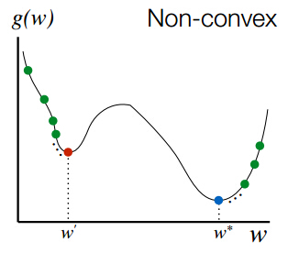
Motivation
Find an optimization method that performs well in a non-convex solution space.
Specifically, we want to compare a gradient-based approach to a genetic algorithm approach using the Pott’s model as our formulation.
Notes:
Given the need for many different approaches, our motivation is to find and test an optimization method that performs well when our solution space is non-convex. Specifically, we can compare the gradient-based methods we have discussed in class to a genetic algorithm using the Pott’s model as out cost function formulation.

Slide 4

Objective Function: Potts Model
Formulation:
Jump Penalty: Forces Piecewise constant solutions
Data term: Couples minimizing candidate x to data y
Non-Convex
Notes:
The formulation that we decided to use is the Pott’s Model, which is a fairly common formulation used for segmentation. This is the formulation, where we are hoping to minimize the L2 norm of the data consistency (which is the second term in this equation) as well as the L0 norm of the gradient of the proposed solution x (which is the first term in the equation). Essentially, the first term causes the solution to be piecewise constant by enforcing a “jump” penalty. The second term is simply the data consistency term that we are familiar with. Since there is an L0 term in the formulation, our solution space will be non-convex.

Slide 5
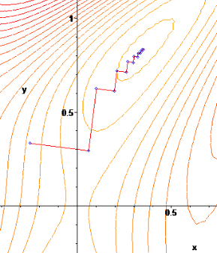
Gradient-Based Optimization Segmentation
How do Gradient-Based Methods work? Take a step proportional to the gradient of the cost function.
What are common gradient-based methods? Steepest descent, conjugate gradients, Newton’s method, Quasi-Newton
Advantages: Generality and simplicity, can handle many types of cost functions
Drawbacks: Converge slowly, sensitive to local minima
Notes:
I’ll talk briefly about gradient-based optimization strategies, since many of you are already familiar with this technique. But essentially how it works is by taking iterative steps proportional to the gradient of the cost function. And this will lead the solution downhill to a local minima. Some of the common gradient-based algorithms are steepest descent, conjugate gradients, Newtons method, and Quasi-Newton methods. The advantages of this technique is that it is intuitive and fairly simple to implement, and it can also handle a large variety of cost functions. However, it can converge slowly and it is sensitive to local minima.

Slide 6
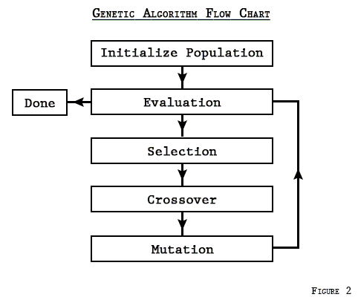
Genetic Algorithm Segmentation
What are genetic algorithms? Used to find global minimum solution for non-linear or non-convex optimization problems
How do Genetic algorithms work? Conceptualized using evolutionary biology
Selection: Keep best performing Solutions (Parents)
Crossover: Create new solutions (Children) from the Successful Parents
Mutation: Create new solutions (Children) by taking successful parent and mutating certain variable to take on random values.
Notes:
The second method of optimization that we will use will be a genetic algorithm based method for minimizing our objective function. This method uses stochastic processes to find a global minimum to a non-convex function. They are conceptualized using evolutionary biology. First a random set of solutions is initialized. Each solution is evaluated against the objective function. The best solutions are passed through and altered using crossover and mutation to form a new set of solutions. The process is repeated until an adequate solution is obtained.

Slide 7
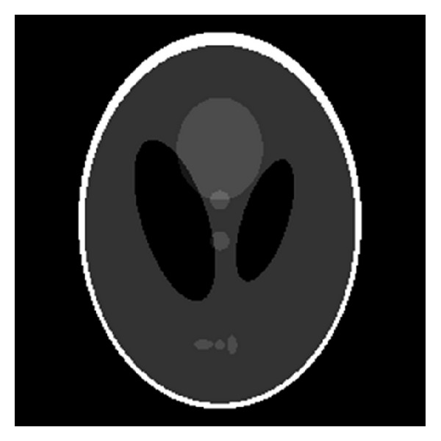
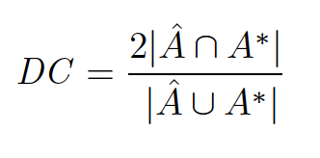
Analysis and Comparison
Shepp-Logan Phantom segmentation using:
Gradient-Based Algorithm
Genetic Algorithm
Computational Time
Performance/Correctness
Qualitative Results
DICE Coefficient
Notes:
The analysis of the GA will be done using a shepp logan phantom. Both the Gradient based and GA will be used to create segmentations, with a ground-truth segmentation being known. The primary metrics will be computation time and the dice coefficent. We will also analyze the results on a qualitative basis.

Slide 8
Objectives
Understanding and modeling the segmentation problem using the Potts Model (Definition of cost function)
Learn how to implement a Gradient-Based Algorithm for segmentation optimization
Learn how to implement a Genetic Algorithm for segmentation optimization
Use both algorithm for a realistic medical imaging application
Compare the performance of each algorithm

Slide 9
Questions

